Slide 1
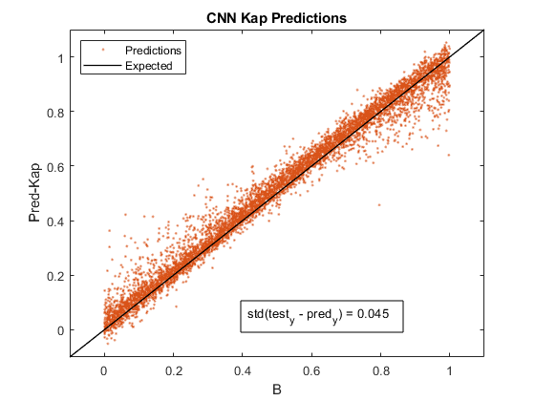
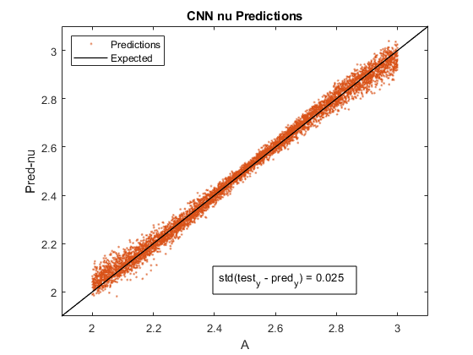
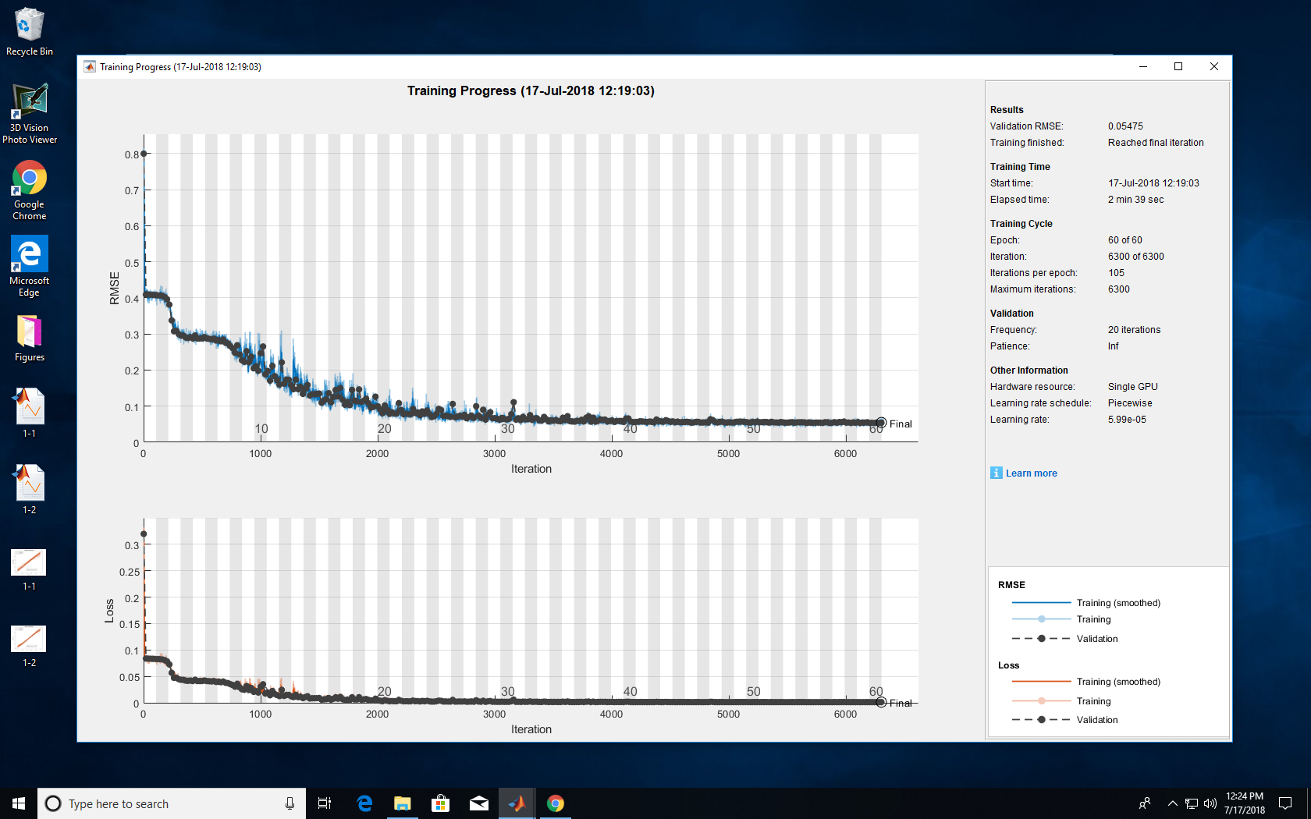
Data30k_FindGoodKap_2
1 1 amplitude
1 1 magnetic field
8 8 energy
400 400 smo
2 3 nu
0 1 Kap
40 40 ld
0 0 ni density
Initial Learn = 0.03
StdKap = 0.045
StdNu = 0.025

Slide 2
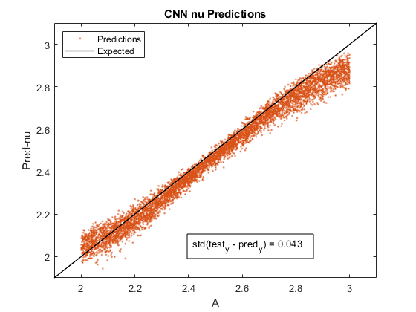
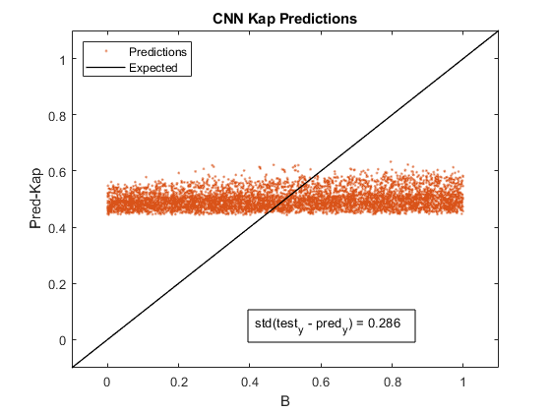
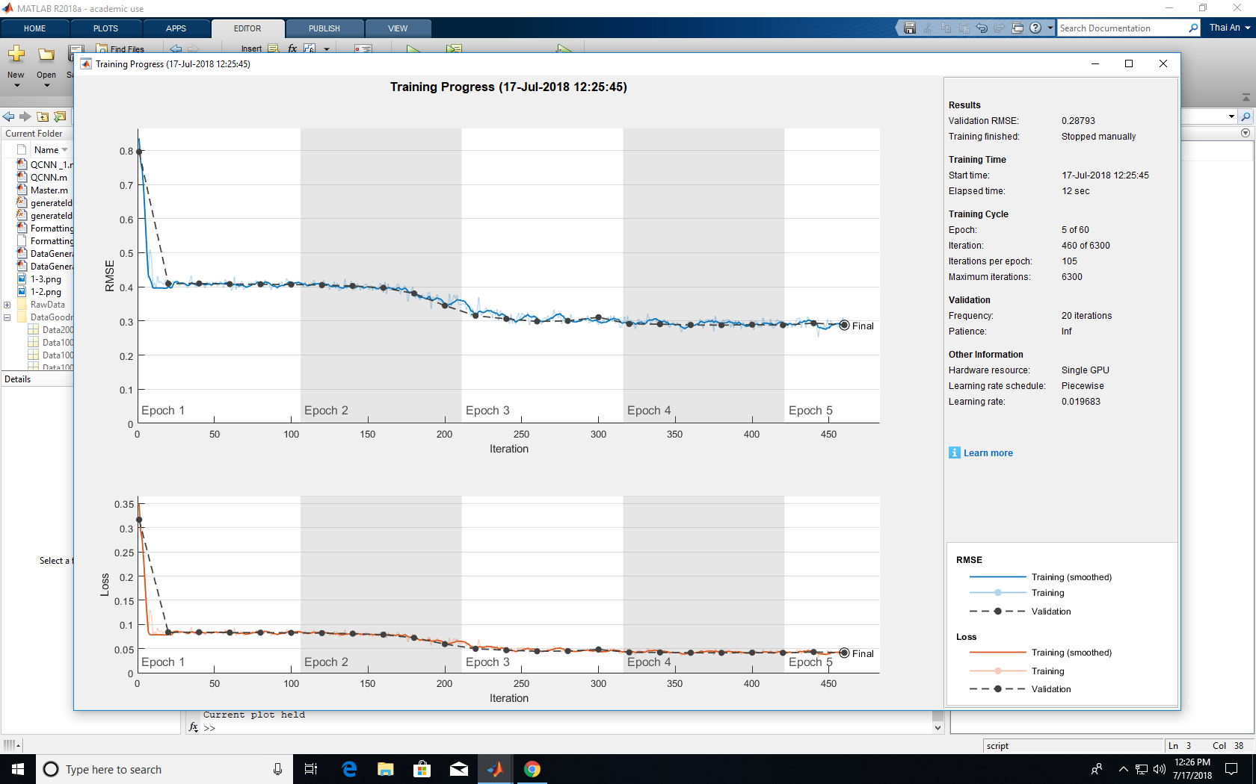
Data30k_FindGoodKap_2
1 1 amplitude
1 1 magnetic field
8 8 energy
400 400 smo
2 3 nu
0 1 Kap
40 40 ld
0 0 ni density
Initial Learn = 0.03
StdKap = 0.286
StdNu = 0.043

Slide 3
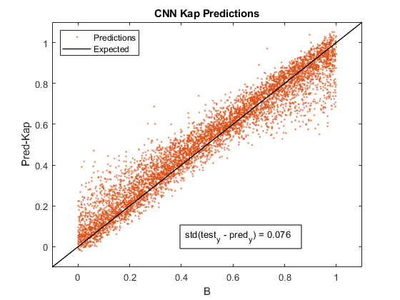
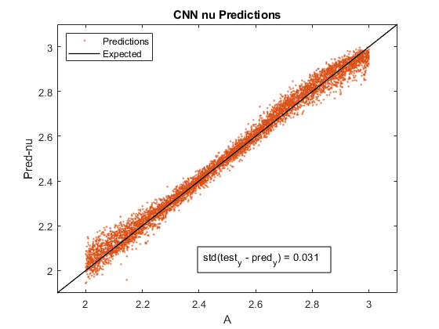
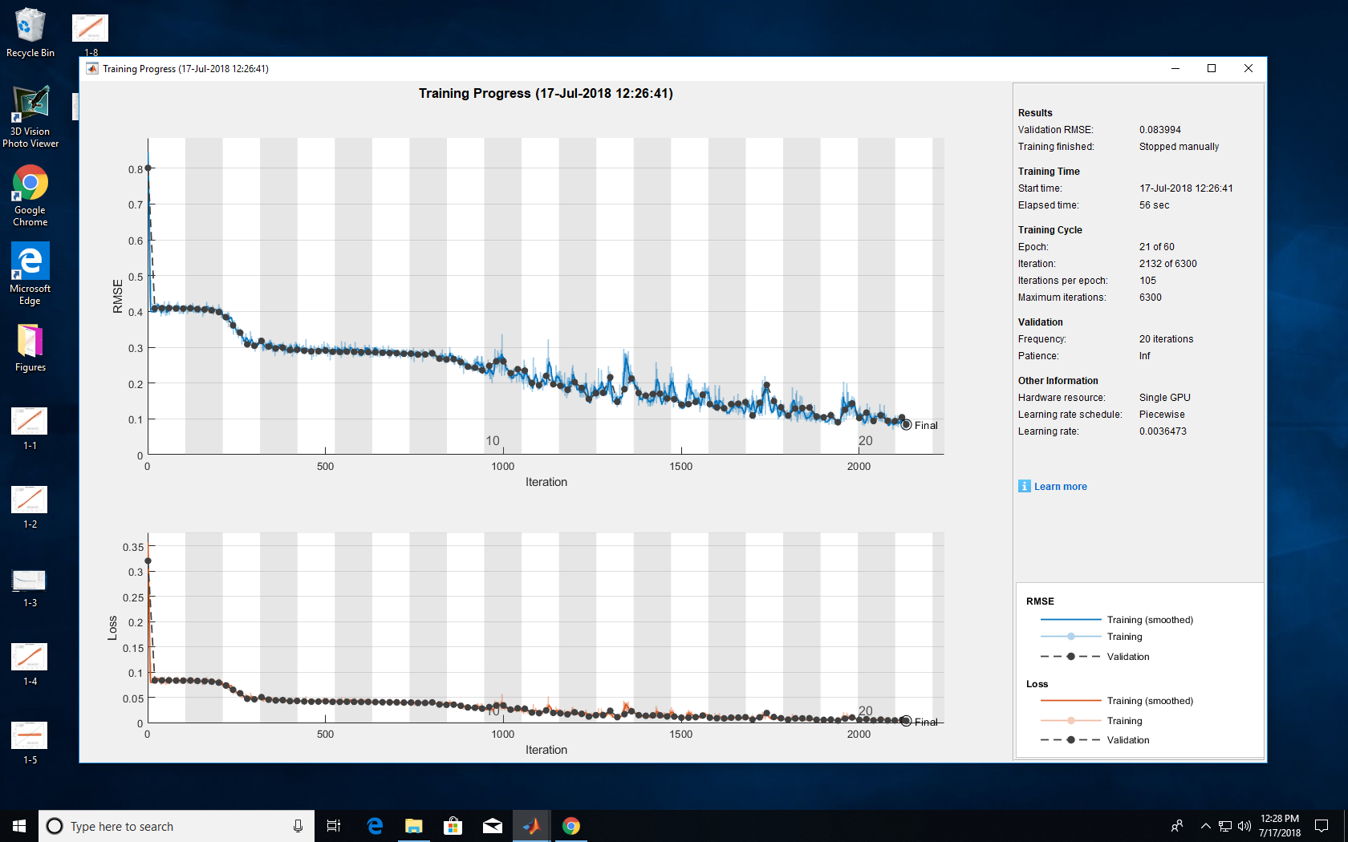
Data30k_FindGoodKap_2
1 1 amplitude
1 1 magnetic field
8 8 energy
400 400 smo
2 3 nu
0 1 Kap
40 40 ld
0 0 ni density
Initial Learn = 0.03
StdKap = 0.045
StdNu = 0.025

Slide 4
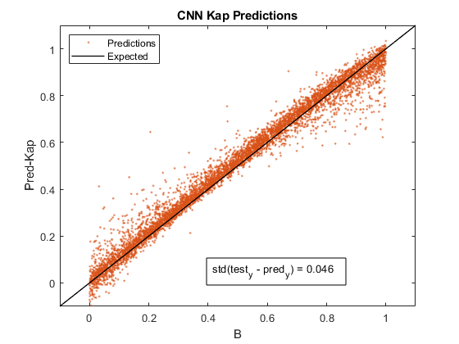
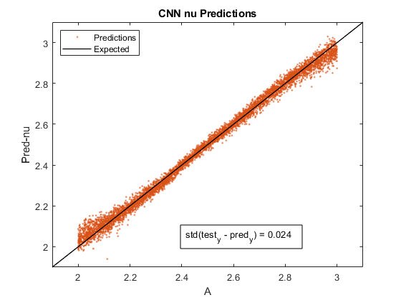
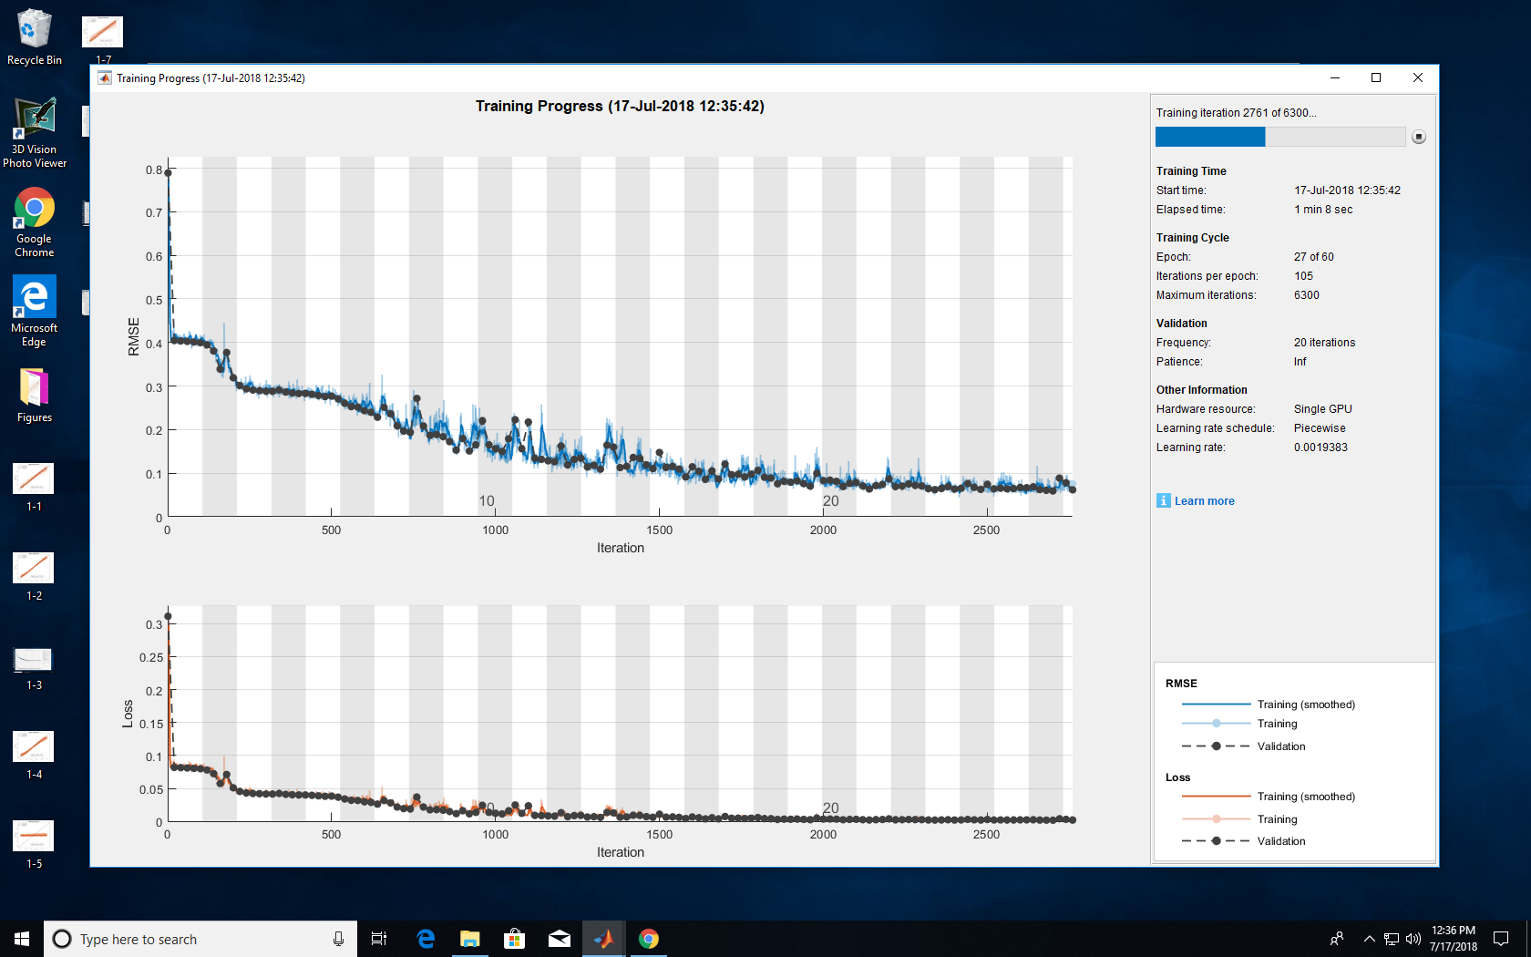
Data30k_FindGoodKap_4
1 1 amplitude
1 1 magnetic field
8 8 energy
400 400 smo
2 3 nu
0 1 Kap
40 40 ld
0.2 0.2 ni density
Initial Learn = 0.03
StdKap = 0.046
StdNu = 0.024

Slide 5
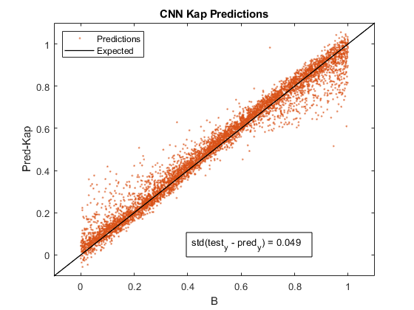
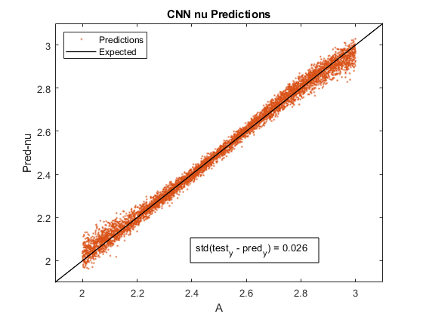
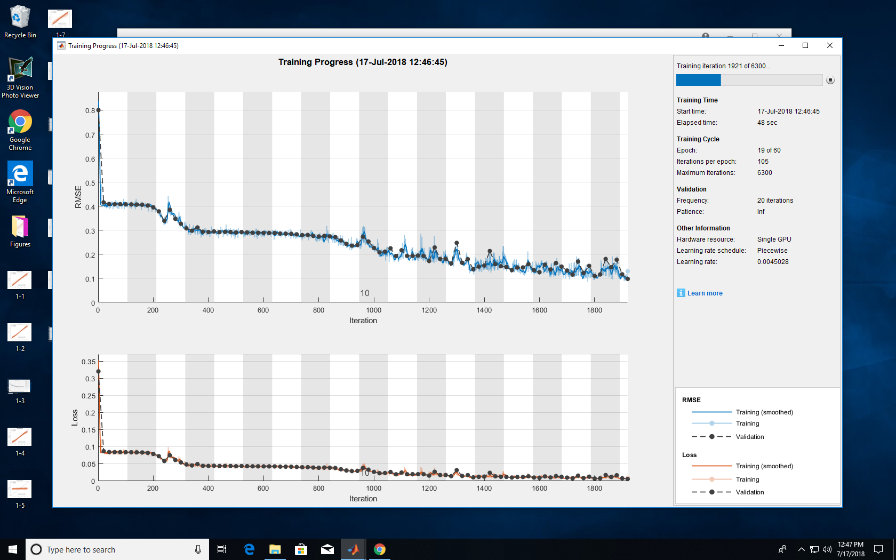
Data30k_FindGoodKap_5
1 1 amplitude
1 1 magnetic field
8 8 energy
400 400 smo
2 3 nu
0 1 Kap
40 40 ld
0.5 0.5 ni density
Initial Learn = 0.03
StdKap = 0.049
StdNu = 0.026

Slide 6
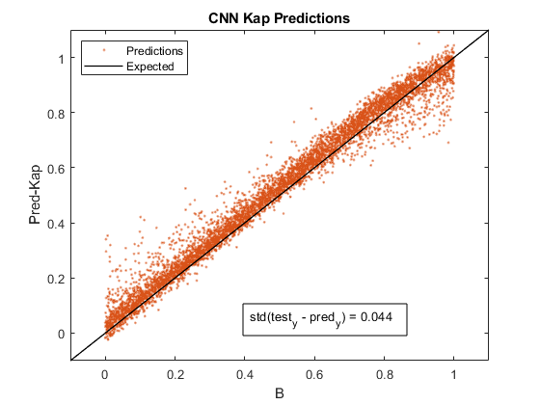
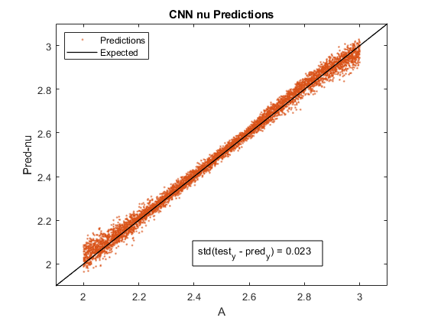
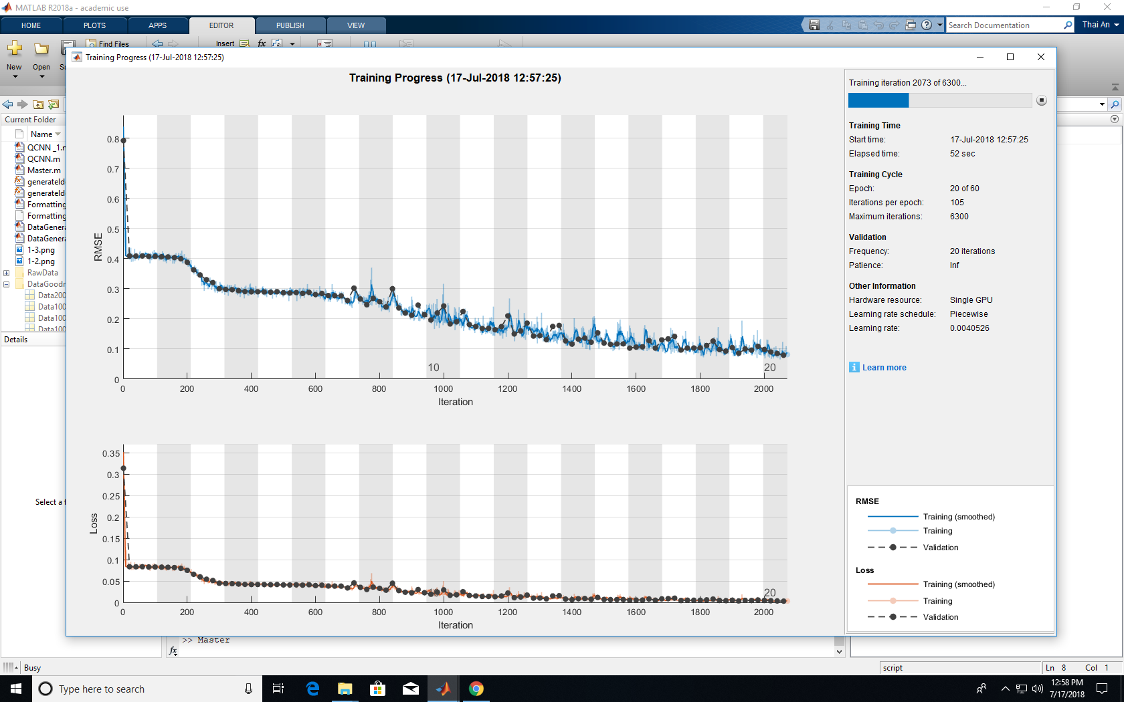
Data30k_FindGoodKap_6
1 1 amplitude
1 1 magnetic field
8 8 energy
400 400 smo
2 3 nu
0 1 Kap
40 40 ld
0.7 0.7 ni density
Initial Learn = 0.03
StdKap = 0.044
StdNu = 0.023

Slide 7
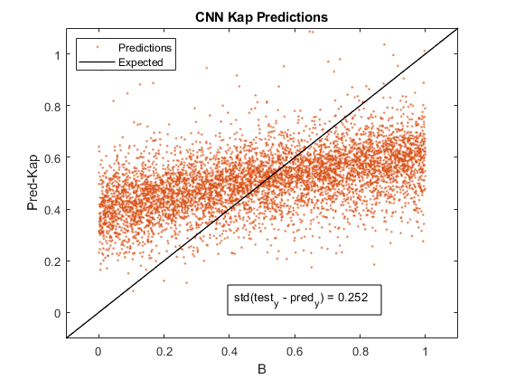
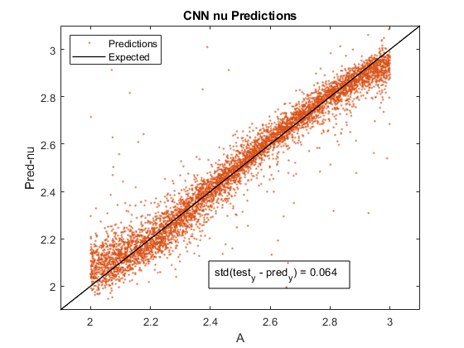

Data10k_FindGoodKap_7
1 1 amplitude
1 1 magnetic field
8 8 energy
400 400 smo
2 3 nu
0 1 Kap
40 40 ld
1 1 ni density
Initial Learn = 0.03
StdKap = 0.252
StdNu = 0.064

Slide 8
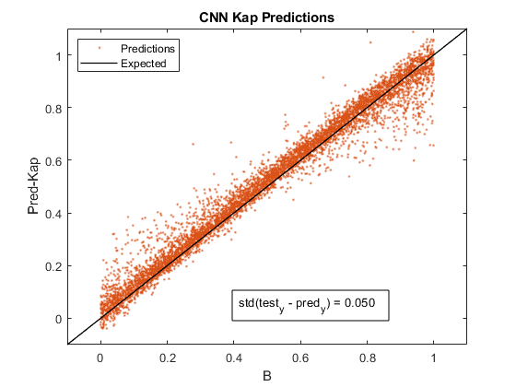
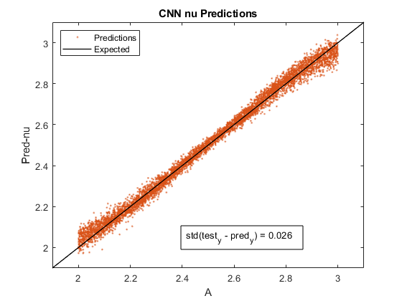
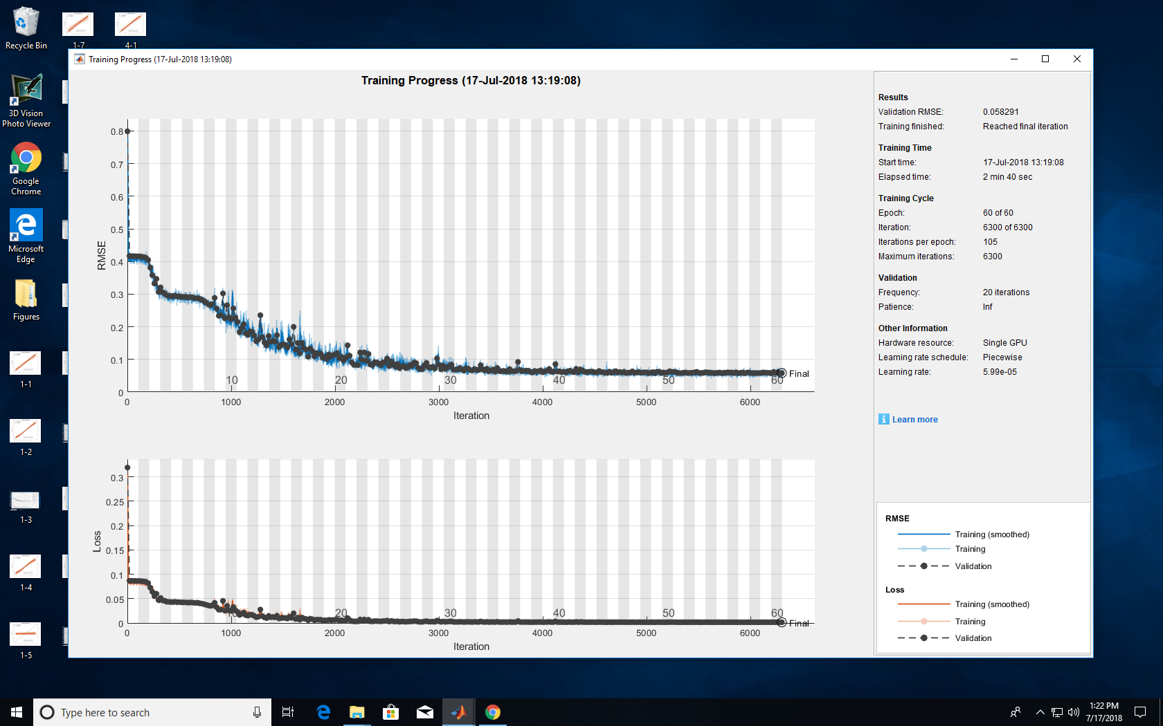
Data30k_FindGoodKap_8
1 1 amplitude
1 1 magnetic field
8 8 energy
400 400 smo
2 3 nu
0 1 Kap
40 40 ld
0.8 0.8 ni density
Initial Learn = 0.03
StdKap = 0.050
StdNu = 0.026

Slide 9

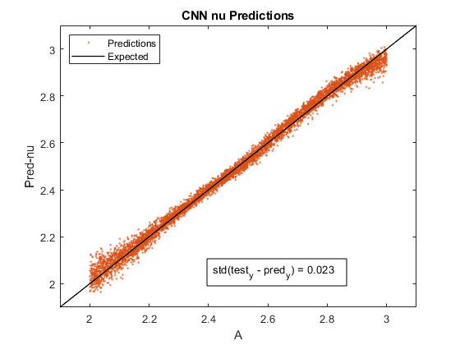
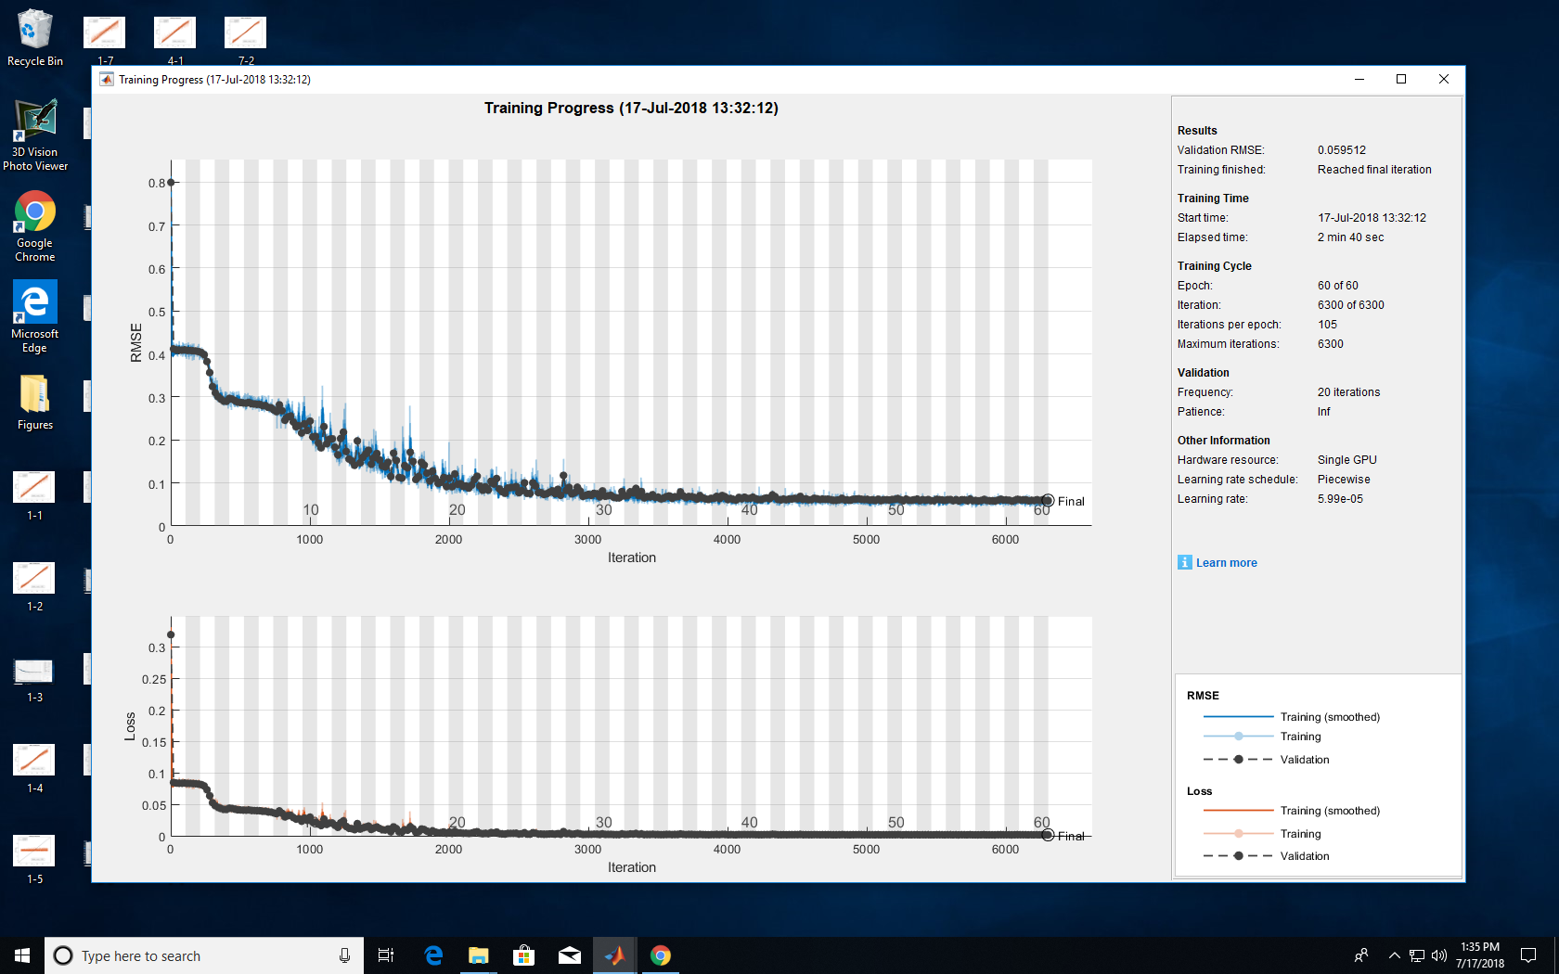
Data30k_FindGoodKap_9
1 1 amplitude
1 1 magnetic field
8 8 energy
400 400 smo
2 3 nu
0 1 Kap
40 40 ld
0.9 0.9 ni density
Initial Learn = 0.03
StdKap = 0.051
StdNu = 0.023

Slide 10
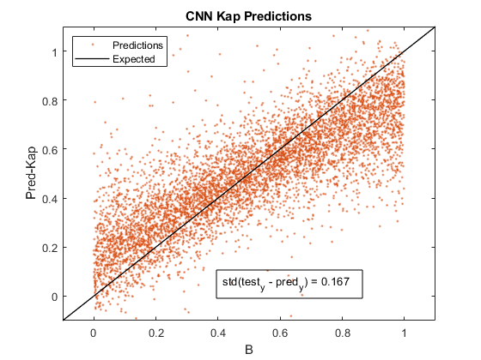
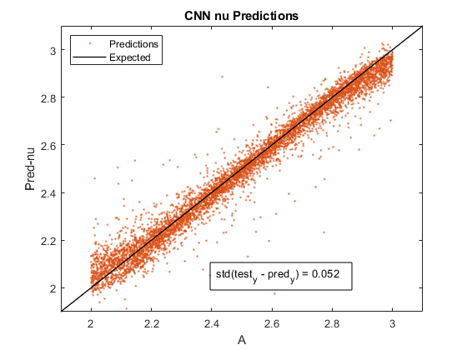
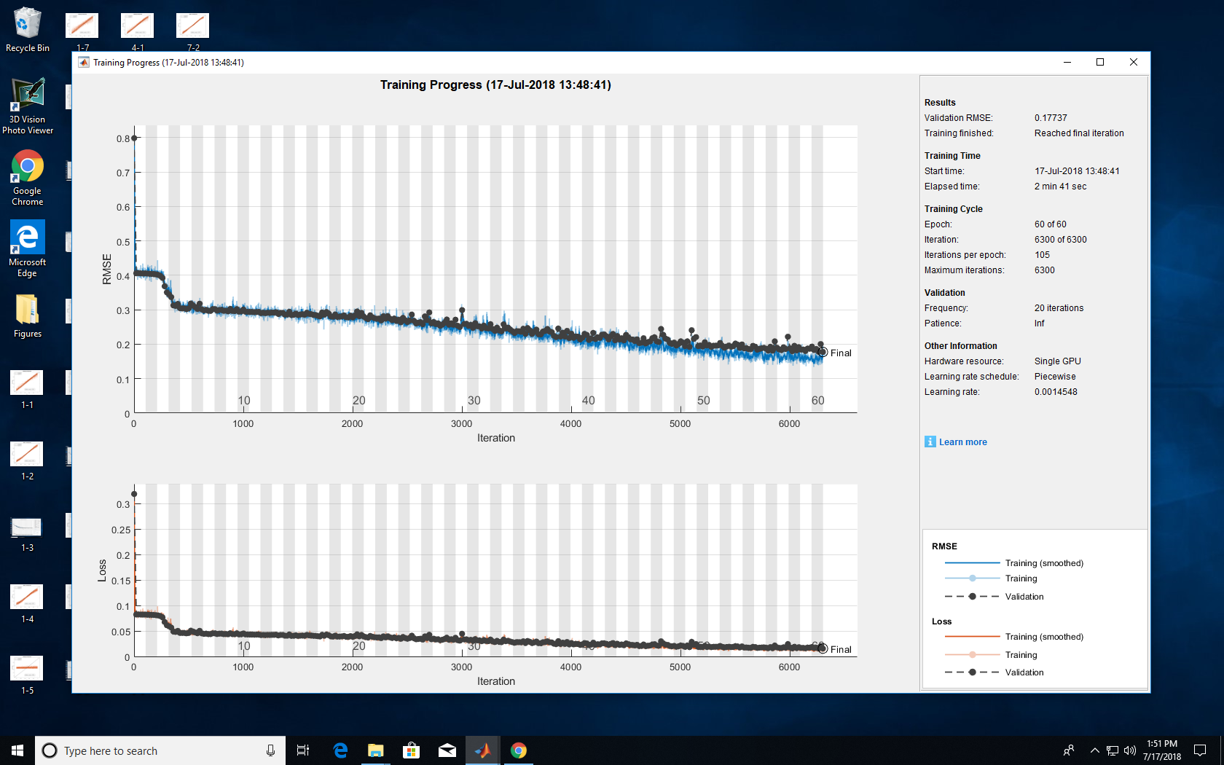
Data30k_FindGoodKap_10
1 1 amplitude
1 1 magnetic field
8 8 energy
400 400 smo
2 3 nu
0 1 Kap
40 40 ld
0.96 0.96 ni density
Initial Learn = 0.03
StdKap = 0.167
StdNu = 0.052

Slide 11
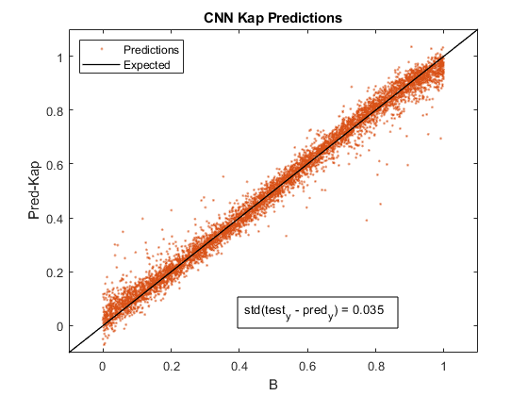
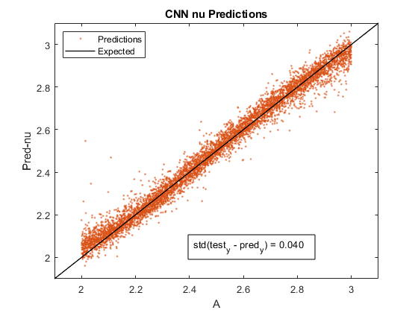
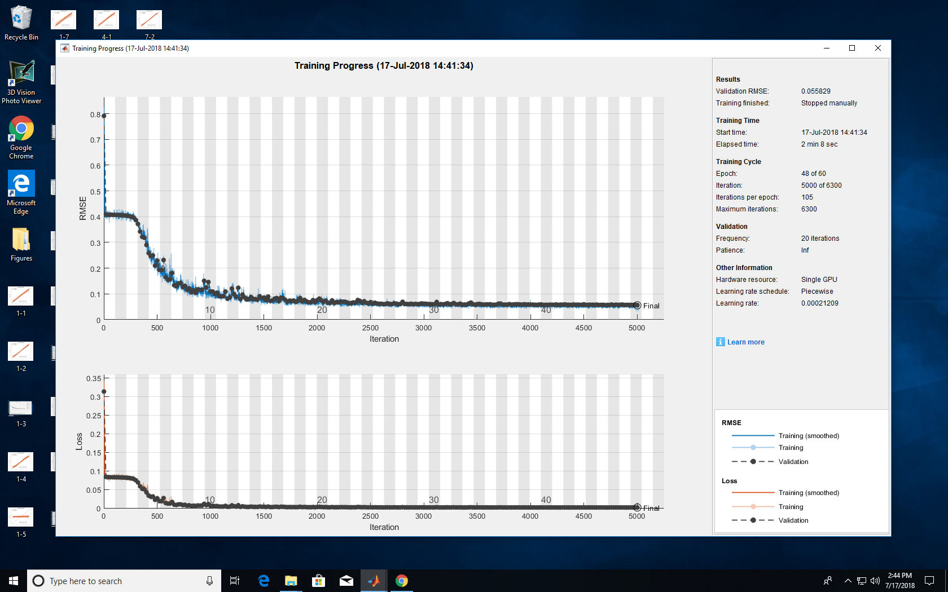
Data30k_FindKappa
1 1 amplitude
1 1 magnetic field
8 8 energy
200 200 smo
2 3 nu
0 1 Kap
40 40 ld
0 0 ni density
Initial Learn = 0.03
StdKap = 0.035
StdNu = 0.046

Slide 12
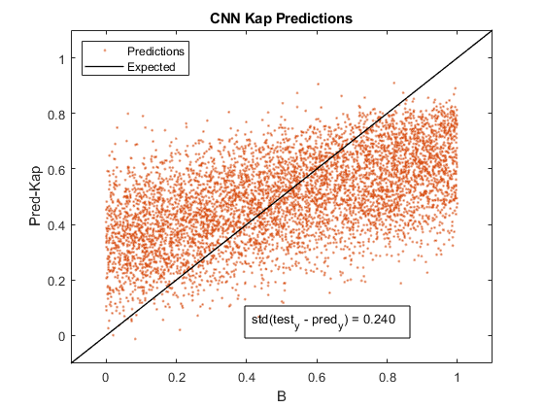
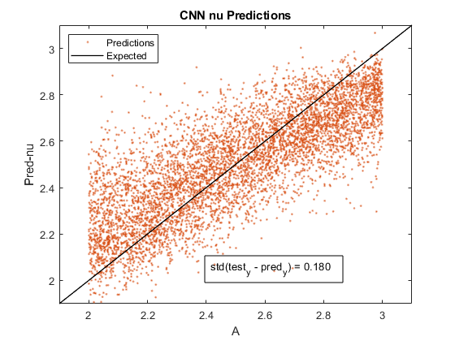
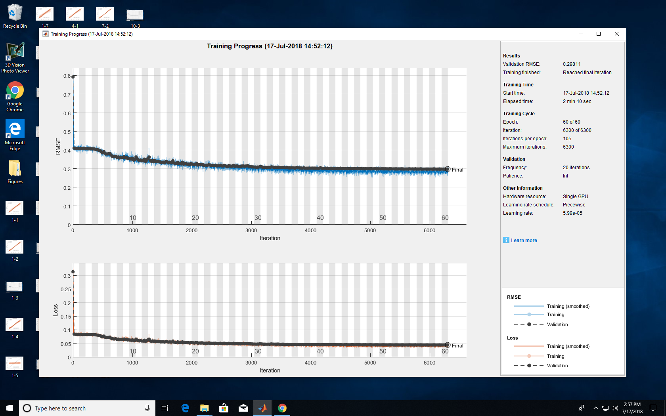
Data30k_Ni_2
1 1 amplitude
1 1 magnetic field
8 8 energy
200 200 smo
2 3 nu
0 1 Kap
40 40 ld
Ni = 2
Initial Learn = 0.03

Slide 13
CANNOT LEARN KAPPA WHEN NUMBER OF IMPURITY IS HIGHER THAN 1

